Slide 1
Yelp Reviews – A Study
A CS223 Class Project
Team Members : Aishwarya Soni, Praveen Subramaniyam, Shivika Sodhi, Prathiba Nagarajan

Slide 2
Introduction
The Need To Process Text
An Introduction to Yelp
Focus of this Project
Overall view of the Project Description

Slide 3
The Need to Process Text
Sentiment Analysis
Spam Filtering
Plagiarism Detection
Smarter Search
Simple Keyword Frequency Analysis
Phrase Extraction

Slide 4
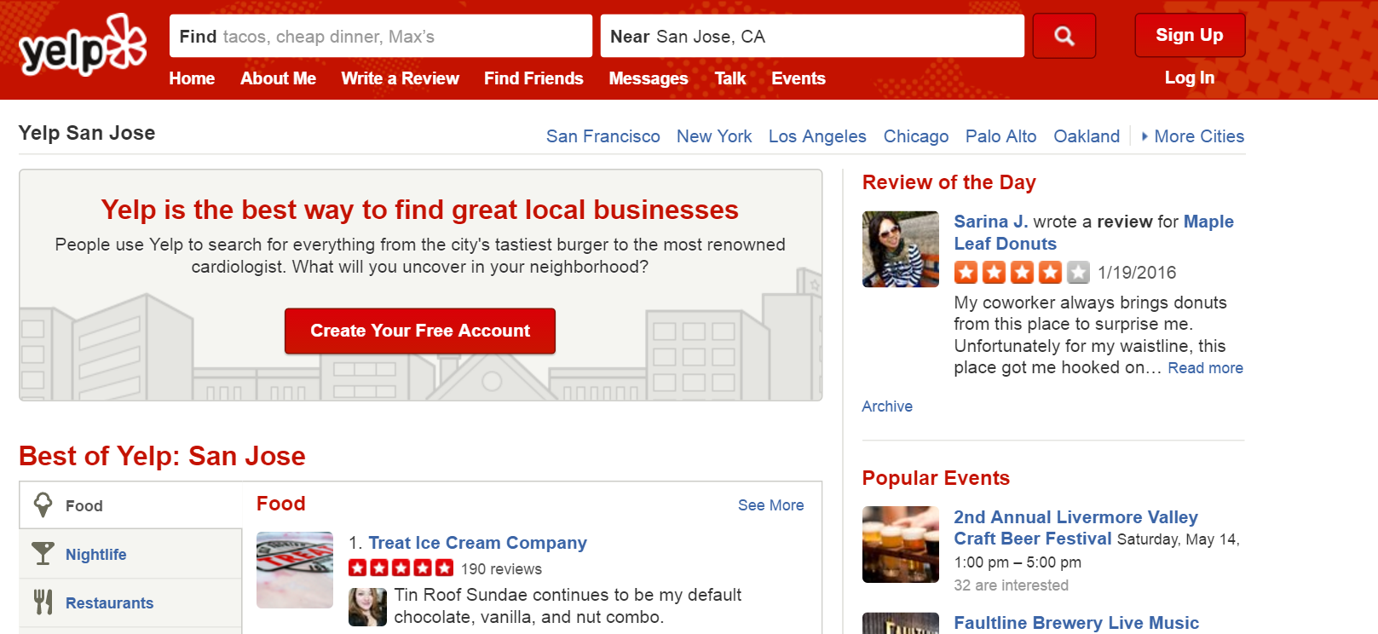
What is Yelp
Yelp is an American MNC , founded in 2004, headquartered in San Francisco, California. It develops, hosts and markets Yelp.com, which crowd-sourced reviews about local businesses, as well as the online reservation service SeatMe and online food-delivery service Eat24 [1].

Slide 5
Focus of this project
Yelp introduced a “Dataset Challenge” (https://www.yelp.com/dataset_challenge/) to gain interesting insights into the data, with challenges such as finding cultural and seasonal trends, infer categories, natural language processing (NLP) etc.
We chose the challenge of NLP, which involved the correlation of reviews’ text and ratings to find positive reviews and negative reviews.

Slide 6
Overall view of the Project Description
Sub Problem One
Extracted business_id where the categories = “food” from a JSON file named yelp_academic_dataset_business.json (65 MB) and wrote them to a CSV.
Sub Problem Two
Removed stopwords using the nltk package from the user reviews.
Applied Naïve Bayes and VADER using nltk, dividing the words into positive and negative reviews based on the stop words based on “stars”.
Sub Problem Three
Compared the results derived from the approached mentioned above.
Extracted the user reviews (“text”) and “stars” from yelp_academic_dataset_review.json (1.80GB) using the business_id extracted from the previous problem.

Slide 7
Database Access
We received five sets of data files containing information of business, users, check-in, reviews, users and tips.
General Format:
{ 'type': 'review', 'business_id': (encrypted business id), 'user_id': (encrypted user id), 'stars': (star ratings), 'text': (review text), 'date': (date, formatted like '2012-03-14'), 'votes': {(vote type): (count)} }
We extracted the review text, the star ratings and the business ID and transferred it to a CSV file, for optimization.

Slide 8
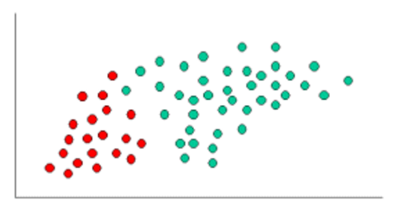
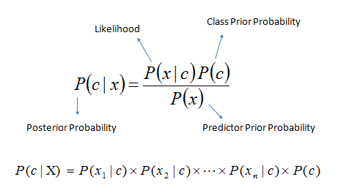
Naïve Bayes Classifier
The objects can be classified as either Green or Red.
Our task is to classify new cases as they arrive, i.e., decide to which class label they belong, based on the currently existing objects.
Formula for Naïve Bayes

Slide 9
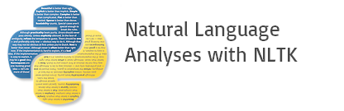
NLTK sentiment analyser
What is NLTK
A tool consisting of a collection of libraries and programs in python that allows for customization and optimization of NLP processes
How did we use it
We downloaded nltk from Canopy’s Package Manager and put our Data Set into the suitable data Structures so that it could be used.

Slide 10

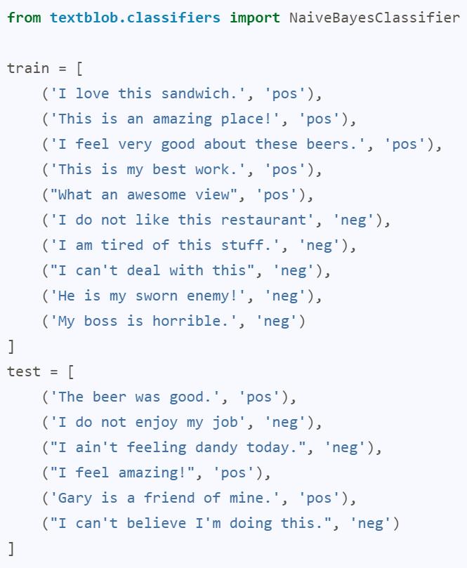
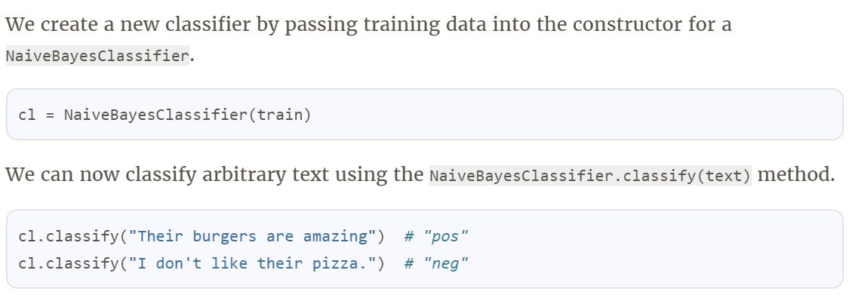
Example
A Tweet Sentiment Analyzer (Simple classification)

Slide 11
Results
Naïve Bayes classifier results – plots
NLTK analyser results – plots
If we can compare,then compare

Slide 12
Future Work
Other than naïve bayes classifier, what all could we have used
Any other learning point from this project

Slide 13
References
https://en.wikipedia.org/wiki/Yelp
http://www.statsoft.com/textbook/naive-bayes-classifier

